Slide 1
CMP2019M
Human-Computer Interaction
Week 3 – Core Concepts: Usability and Design Heuristics

Slide 2
Last week
Understanding Human Cognition
  Perception
  Memory
  Learning

Slide 3
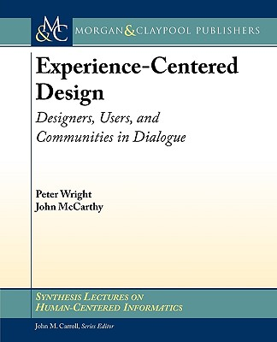
Reading
Philosophy and practice of user centered design:
Experience-Centered Design:
Designers, Users, and
Communities in Dialogue,
by McCarthy & Wright

Slide 4
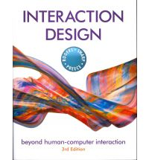
Reading
Core Concepts in HCI:
Interaction Design: Beyond
Human-Computer Interaction,
by Sharp, Rogers, & Preece
This one tracks the structure of
the course quite well.
And has lots of pictures.
Notes:
I expect everyone to read this. Inprevious years we have basically just followed the textbook. This year, I trust you to read it in your own time & in the module we will do more hands-on, engaging, research-oriented work

Slide 5
This week
A brief look through some core concepts in HCI:
Part I: Understanding Human Cognition (Psych 101)
  Perception,
  Memory
  Learning
Part II: Designing for Human Cognition
  Usability
  Design Heuristics
    Sheiderman & Nielsen
Notes:
While this stuff is not the focus of this course, it is certainly the type of stuff you would be expected to know about
More about interface design

Slide 6
Part II:
Designing to Accommodate Human Cognition

Slide 7
Defining Usability

Slide 8
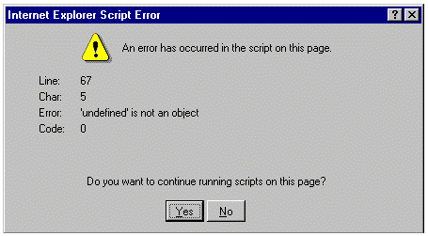
What is Usability?
?

Slide 9
What is Usability?
“The effectiveness, efficiency and satisfaction with which specified users achieve specified goals in particular environments.” ISO 9241

Slide 10
What is Usability?
Lots of different ways of considering / measuring this
It depends on what the software is supposed to do
Efficiency
  Time taken to do task
  Errors
Effectiveness
  Number of tasks completed in a given time
Satisfaction
  Questionnaires

Slide 11

Usability
Nielsen (1993): Usability Engineering
There are vast amounts of usability research – progress in instruments, procedures, specialised for different user groups / devices
It is inherent in the design of most software / devices
Notes:
We will do some usability evaluation later in the module

Slide 12
Designing Usable Systems

Slide 13
What are Usability Heuristics?
Essentially rules-of-thumb that “experts” use to ensure that their software follows established usability principles
They are used primarily because they have been found useful.
Applied before software is exposed to real people.
There are a few different versions
  Nielsens (1993) 10 usability heuristics
  Schneidermans (1998) 8 golden rules

Slide 14
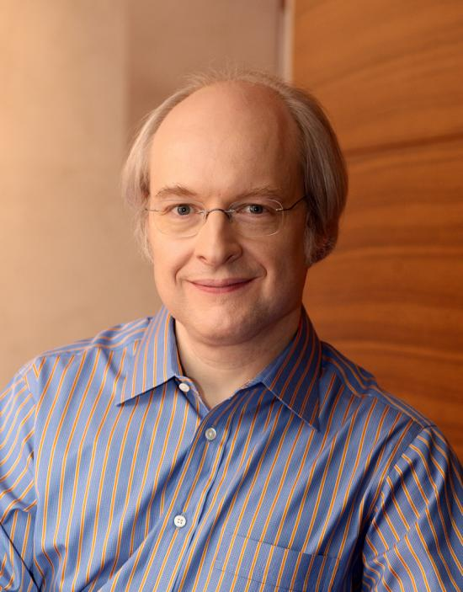

Nielsen & Shneiderman
@benbendc

Slide 15
What are Usability Heuristics?
A lot of these concepts are based on our understanding of perception, memory & learning (cognitive psychology)
The rest of this lecture will look (very) briefly at these

Slide 16
Nielsen’s 10 Usability Heuristics
http://www.useit.com/papers/heuristic/heuristic_list.html
Visibility of system status
Match between system and the real world
User control and freedom
Consistency and standards
Error prevention
Recognition rather than recall
Flexibility and efficiency of use
Aesthetic and minimalist design
Help recognize, diagnose, and recover from errors
Help and documentation

Slide 17
Shneiderman’s 8 Golden Rules
http://lncn.eu/dtu
Strive for consistency.
Enable frequent users to use shortcuts.
Offer informative feedback.
Design dialog to yield closure.
Offer simple error handling.
Permit easy reversal of actions.
Support internal locus of control.
Reduce short-term memory load.

Slide 18
Do these heuristics make sense?
Why (not)?

Slide 19
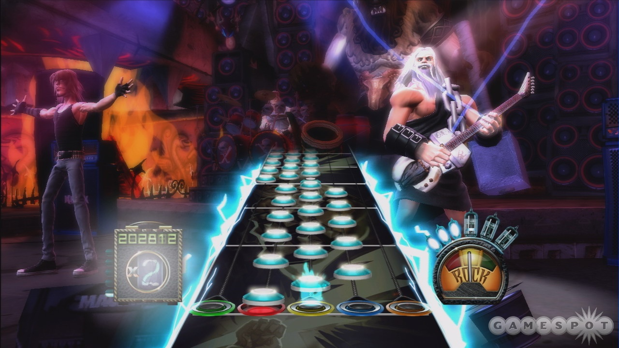
GAMES EXAMPLE
What about…

Slide 20
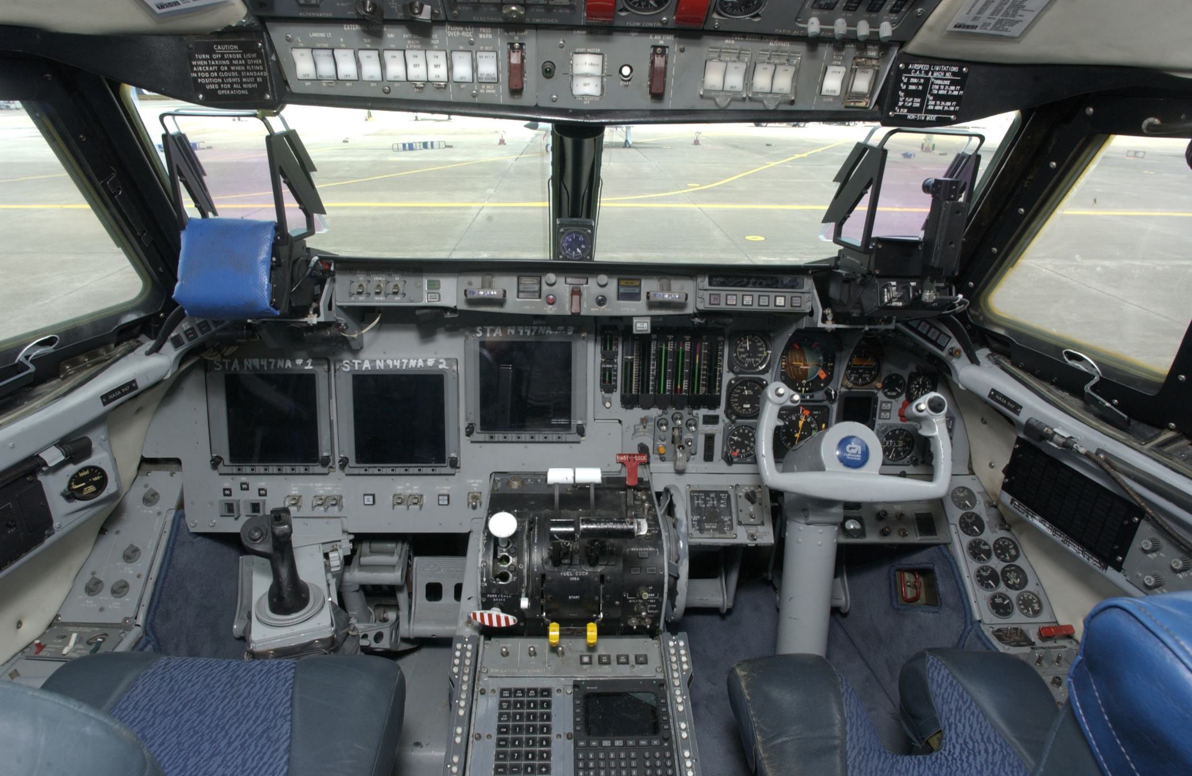
Notes:
Looks like a plane cockpit, looks confusing and complex and like you need to learn a ton of things

Slide 21


Slide 22

In some cases, complexity
is “good” because it
simulates the real world
Can’t always simplify –
but doesn’t mean you
shouldn’t try your best as
a designer if you have the
freedom to do so!
Find suitable solutions

Slide 23
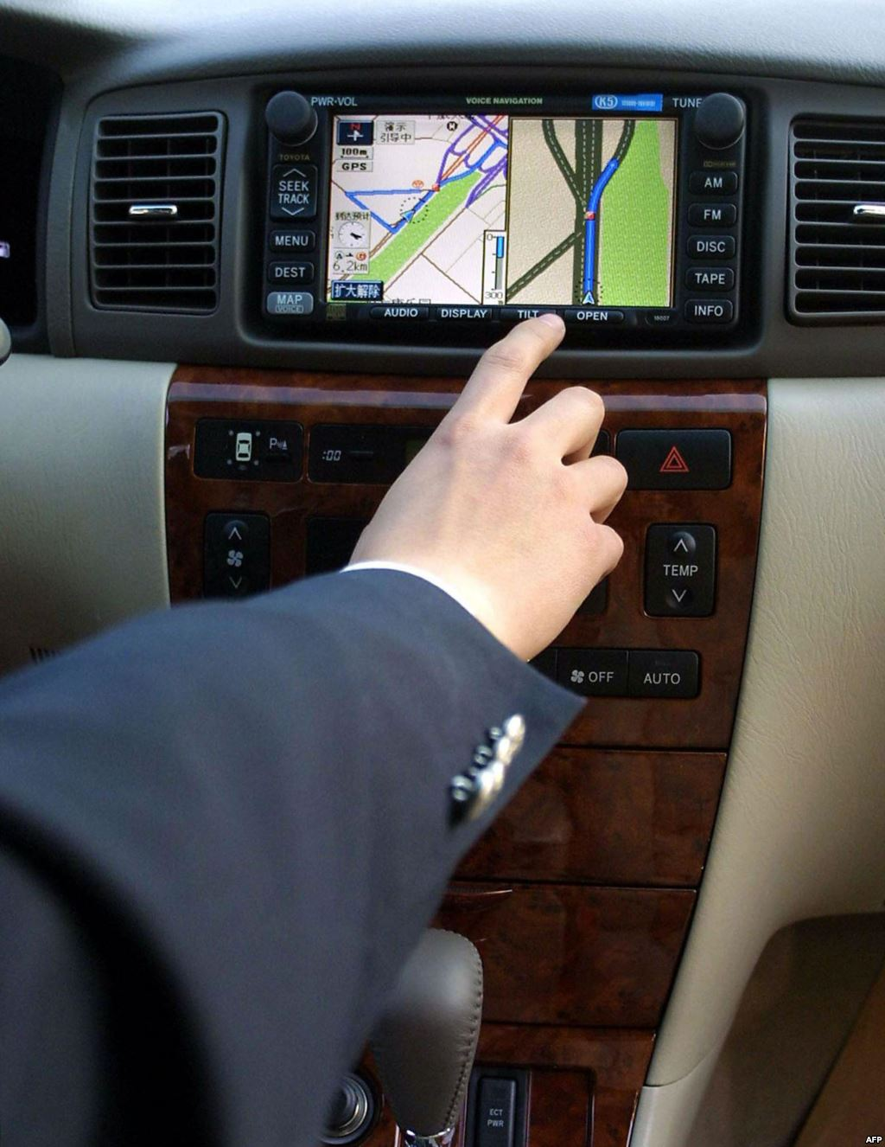
Because in some cases,
complexity is a horrible
idea – not just annoying,
but putting lives at risk
Particularly important as
technology makes its
way into our daily lives!
Be mindful – if you’re the
designer, you carry
responsibility!

Slide 24
Next week:
Beyond Usability –
Acccessible Design

Slide 25
Remember:
We should care about cognition etc. because our body is our interface to communicate with technology.
Notes:
Closely related to Psychology. Psych is not just understanding people and their problems – there’s also a “biological” school that is interested in how our bodies work, for example, what exactly goes on in our brain when we’re trying to make a difficult decision – lots of MRI stuff etc.

Slide 26


Slide 27
(Most things these days are designed for the average white male, and while that’s good news for a lot of people in this room, it doesn’t quite work for everybody.)
Notes:
Closely related to Psychology. Psych is not just understanding people and their problems – there’s also a “biological” school that is interested in how our bodies work, for example, what exactly goes on in our brain when we’re trying to make a difficult decision – lots of MRI stuff etc.

Slide 28
Do you have any questions?

